Slide 1
Historical Analysis Of College Scorecard
Group B
Atinder Singh
Kunal Pritwani
Dharmesh Soni
Mounika Vallabhaneni

Slide 2
Agenda
Introduction
Specification of Data Set
Data Analysis Tools
Cluster Information
Terms and Terminology
Queries and Outputs
Conclusion
Github
References

Slide 3
INTRODUCTION
We are to analyze the basic fundamentals of college which are important factors in big data analytics.
This kind of data is analyzed by big name analyst for big money as this kind of analysis provides insight on different aspects of college.

Slide 4
Specification of Data Set
Data is collected from the site. : https://www.kaggle.com/kaggle/college-scorecard
We have historical data of over 100,000 colleges in the US spanning over 14 years.
Data Size – 1.33 GB
File Format – CSV ( Comma Separated Values)

Slide 5
Cluster Information:
Community Data Bricks Cluster
Memory – 6GB
CPU Cores – 0.88 Cores
CPU Node – 1 Master Node

Slide 6
Tools and Terminologies
Data Analysis Tools:
Community Data Bricks
Databricks fully manages Apache Spark clusters in the cloud, giving it the ability to ingest, analyze and visualize the data.
This platform includes many features like multiuser support, Interactive workspace and more.
Visualization Tools
Tableau 9.2

Slide 7
Terms and Terminology:
Mean Earnings.
Mean earnings are for the institutional aggregate of all federally aided students who enroll in an institution each year and who are employed but not enrolled.
Average Net Price of a College.
There are several elements in the Avg Net Price that are derived from the full cost of attendance (including tuition and fees, books and supplies, and living expenses) minus federal, state, and institutional aid, for undergraduate student.

Slide 8
Verbal and Math Sat Score Analysis.
Test scores of enrolled students are not reported for all institutions, but may help students to find a school that is a good academic match. The query includes 75th percentiles of SAT Verbal (SATVR75), SAT Math (SATMT75)
Percent of Undergraduates Receiving PELL GRANT
This element (PCTPELL), shows the share of undergraduate students who received Pell Grants in a given year. This is an important measure of the access a school provides to low-income students.

Slide 9
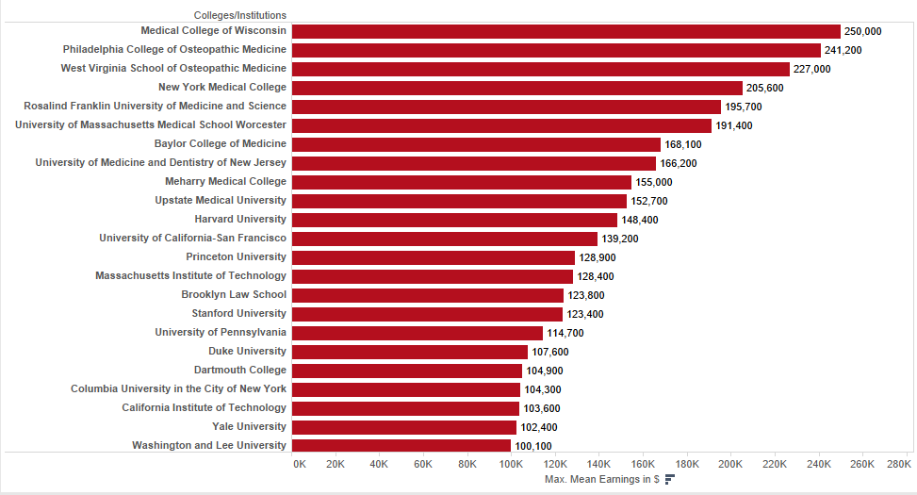
Mean Earnings
results = sqlContext.sql('SELECT INSTNM, mn_earn_wne_p10, STABBR FROM Scorecard_Project order by (mn_earn_wne_p10) desc') -> display(results)

Slide 10
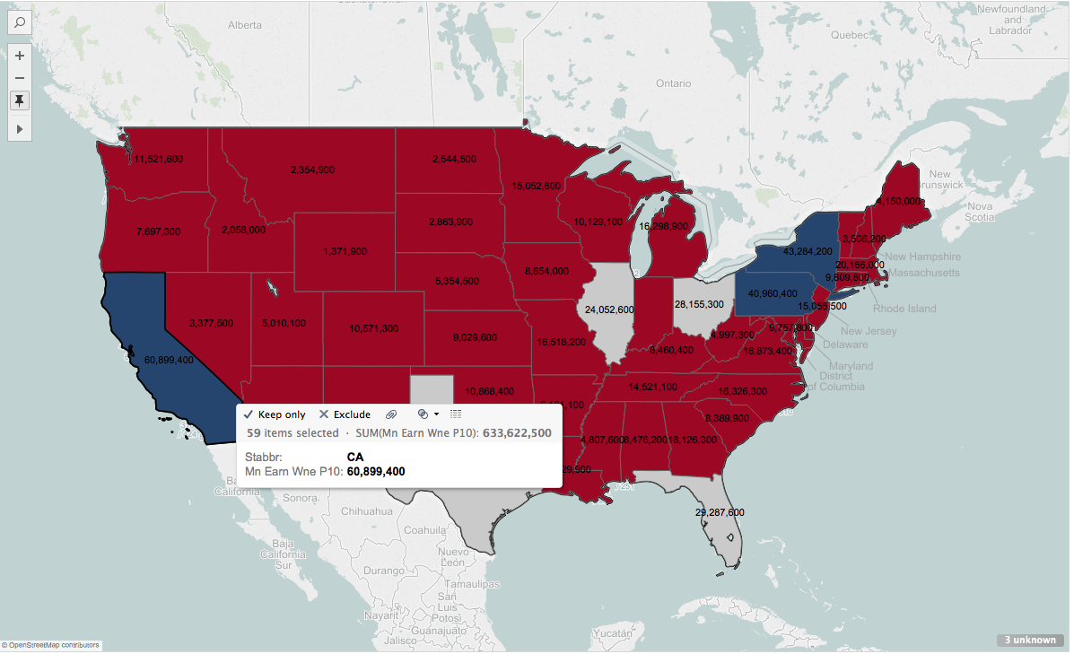
Mean Earnings with Respect to States.

Slide 11
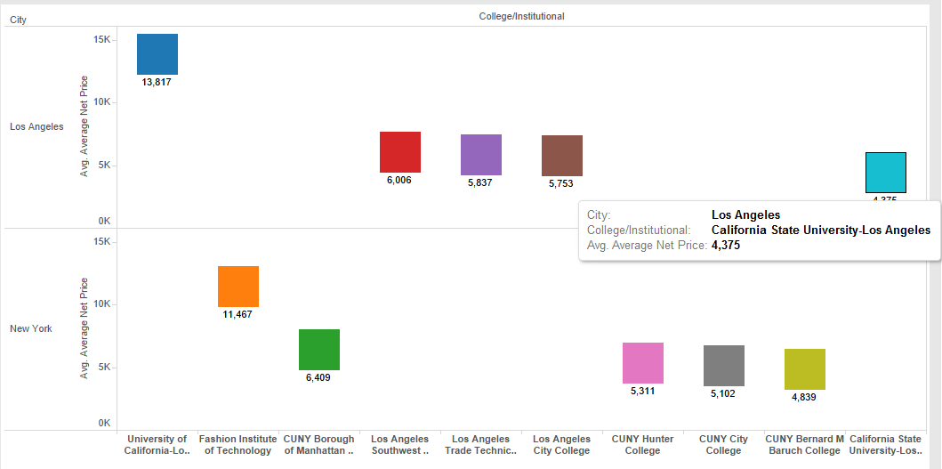
Comparing Average Net Price of Two States
results = sqlContext.sql('SELECT INSTNM, NPT4_PUB, CITY FROM Scorecard_Project where City = "Los Angeles" or City = "New York" order by LENGTH(NPT4_PUB) desc') -> display(results)

Slide 12
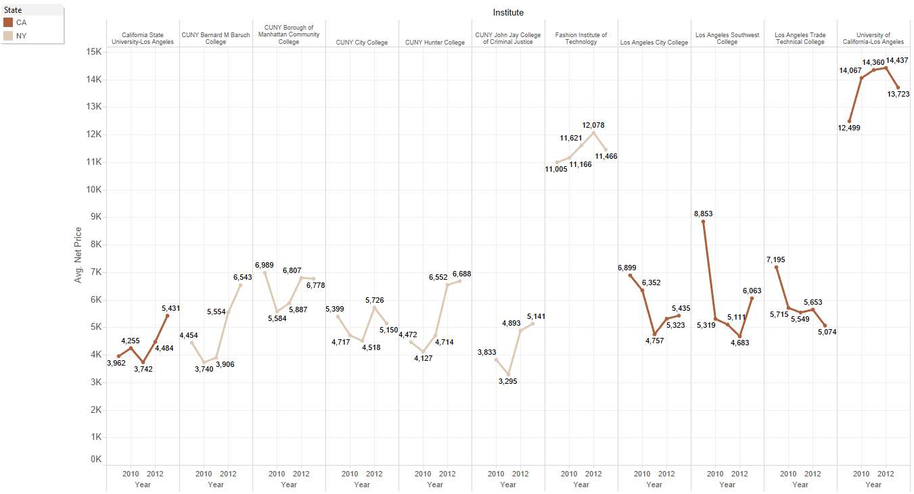
Year Wise Net Price

Slide 13
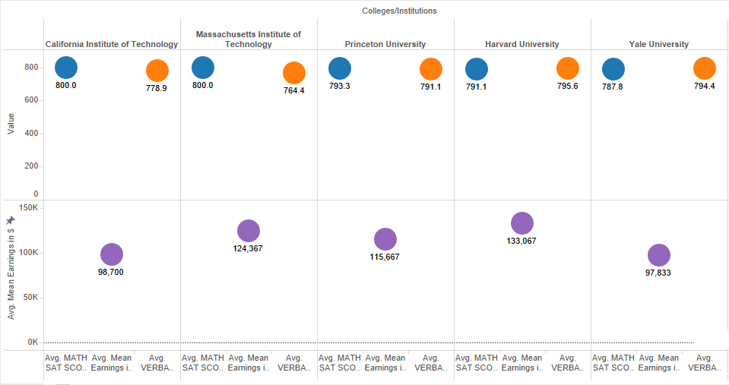
SAT Scores in Different Colleges
results = sqlContext.sql('SELECT INSTNM, SATVR75, SATMT75, mn_earn_wne_p10 FROM Scorecard_Project where SATMT75>500 order by SATMT75 desc, SATVR75 desc) -> display(results)

Slide 14
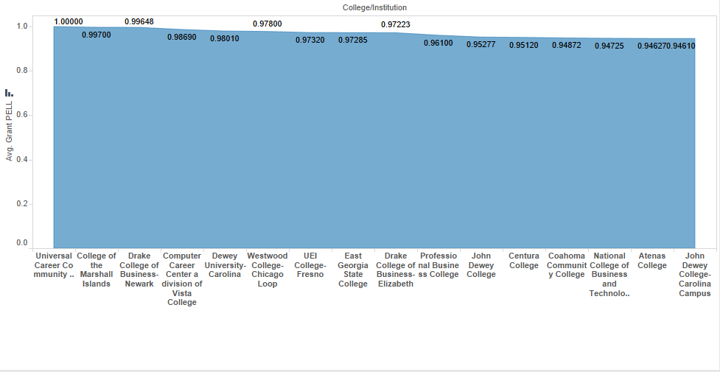
Comparing Average Undergraduates Receiving PELL GRANT
results = sqlContext.sql('SELECT INSTNM, CITY, STABBR, UGDS, PCTPELL FROM Scorecard_Project where UGDS>1000 order by PCTPELL desc')
-> display(results)

Slide 15
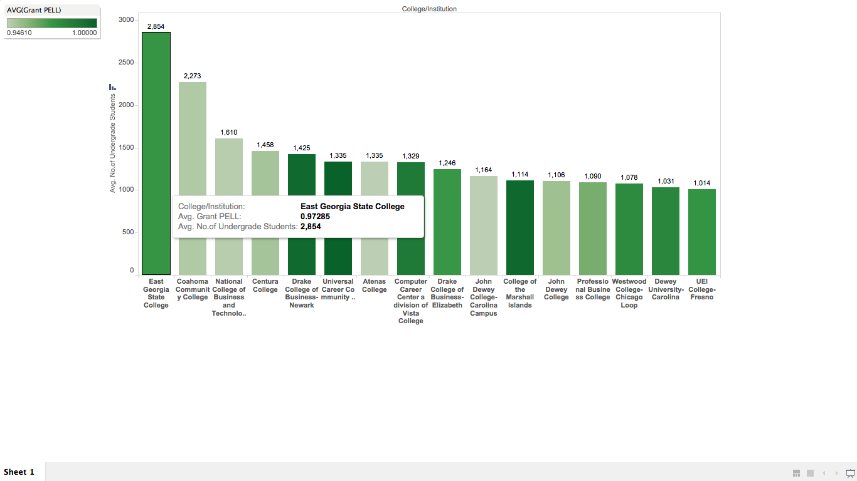
Average Undergraduates Receiving PELL GRANT in Each College

Slide 16
CONCLUSION
We would like to conclude that choosing a college for your undergrad right after high school is every child’s nightmare and insights like these give you a clear picture of the where about of the college. This kind of insight will be charged huge sum by data analyst for what we just presented.

Slide 17
GITHUB
https://github.com/atinder03/CollegeScorecardAnalysis

Slide 18
Reference
https://www.kaggle.com/kaggle/college-scorecard
http://heinz.cmu.edu/school-of-public-policy-management/public-policy-management-msppm/msppm-track-options/data-analytics-track/index.aspx

Slide 19
THANKYOU

